Slide 1
Important

Slide 2
Refreshments.
Unfortunately, we can’t have food and drinks in the car show, but if you pay for 1 £50 meal ticket per person, you can have a free Mc Donald's.

Slide 5
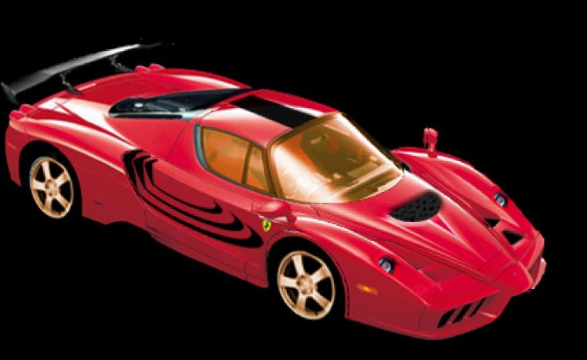
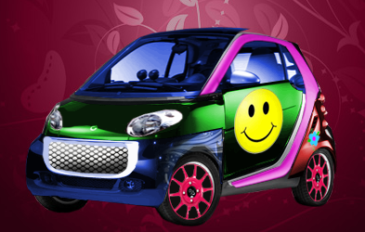
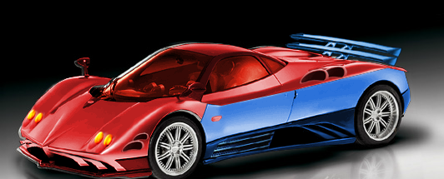
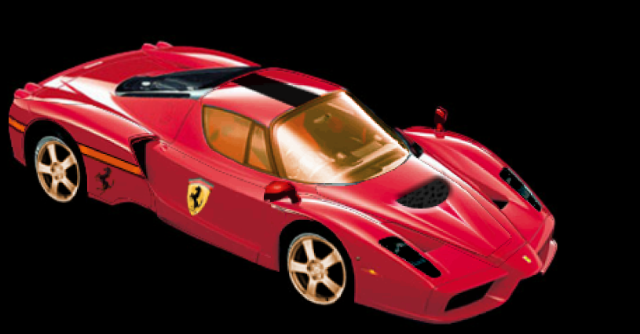

Slide 6
Smart
S1

Slide 7
Pagina Zonda

Slide 8
Ferrari Enzo

Slide 9
Aston Martin V8

Slide 10
Audi Q7

Slide 11
Enjoy the show!
☺
☺
☺

